Slide 1
Polymorphism and Interfaces
Inheritance in Action

Slide 2
Polymorphism
The term polymorphism literally means “having many forms”
A polymorphic reference is a variable that can refer to different types of objects at different points in time
The method invoked through a polymorphic reference can change from one invocation to the next
All object references in Java are potentially polymorphic
This allows collection classes of the class Object
because all classes inherit from the class Object

Slide 3
Polymorphism
Suppose we create the following reference variable
Occupation job;
Java allows this reference to point to an Occupation object, or to any object of any compatible type
This compatibility can be established using inheritance or using interfaces
Careful use of polymorphic references can lead to elegant, robust software designs
Handling code is much simpler

Slide 4
References and Inheritance
An object reference can refer to an object of its class, or to an object of any class related to it by inheritance
For example, if the Holiday class is the parent of Christmas, then a Holiday reference could be used to point to a Christmas object
Holiday special = new Christmas();

Slide 5
Polymorphism via Inheritance
It is the type of the object being referenced, not the reference type, that determines which method is invoked
Suppose the Mammal class has a method called move, and the Horse class overrides it
Now consider the following invocation
pet.move();
If pet refers to a Mammal object, it invokes the Mammal version of move; if it refers to a Horse object, it invokes the Horse version

Slide 6
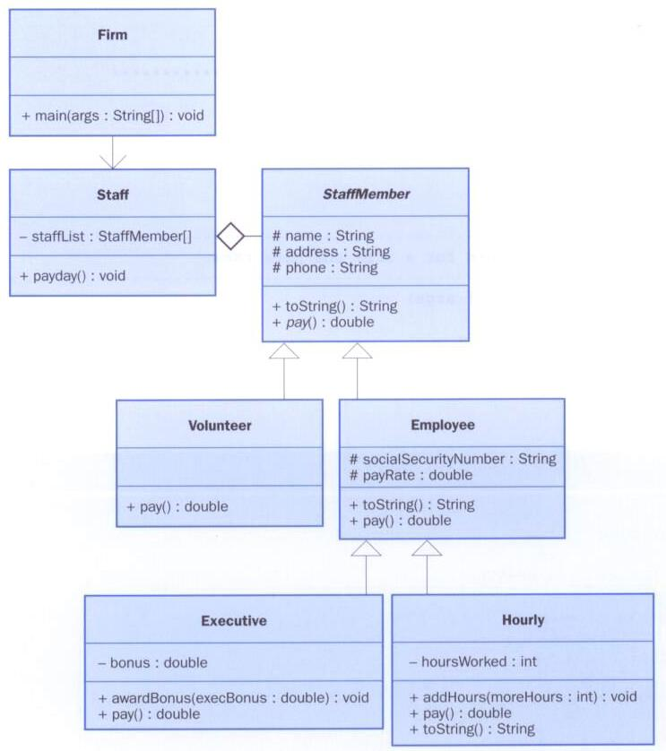
Let’s look at an example that pays a set of employees using a polymorphic method
Notes:
The unfilled diamond means aggregation. One class contains others.

Slide 7
Handling Code
If we had a collections of Mammal objects
Then we could write code to loop through them and call their move() methods
So far so good
The code would still work for any future classes that inherit from Mammal and it would inherit move() from Mammal or override it with its own
The handling code stays the same
It calls the generic move() in Mammal if a more specialised move() has not been provided
The code is very extensible as more Mammals can be added in the future and each can move in its own way (if it overrides Mammal’s move())
As the designer of the Mammal class, we may decide that having a generic move() method is pointless
We could define it as abstract and therefore not provide a definition but ensure any derived classes do

Slide 8
Interfaces
A Java interface is a collection of abstract methods and constants
An abstract method is a method header without a method body
An abstract method can be declared using the modifier abstract, but because all methods in an interface are abstract, usually it is left off
An interface is used to establish a set of methods that a class will/must implement

Slide 9
Interfaces
interface is a reserved word
None of the methods in
an interface are given
a definition (body)
public interface Doable
{
public void doThis();
public int doThat();
public void doThis2(float value, char ch);
public boolean doTheOther(int num);
}
A semicolon immediately
follows each method header

Slide 10
Interfaces
An interface cannot be instantiated
Methods in an interface have public visibility by default
A class formally implements an interface by
stating so in the class header
providing implementations for each abstract method in the interface
If a class states that it implements an interface, it must define all methods in the interface

Slide 11
Interfaces
public class CanDo implements Doable
{
public void doThis ()
{
// whatever
}
public void doThat ()
{
// whatever
}
public void doThis2(float value, char ch)
{
//whatever
}
public boolean doTheOther(int num)
{
//whatever
}
}
implements is a
reserved word
Each method listed
in Doable is
given a definition

Slide 12
Interfaces
A class that implements an interface can implement other methods as well
In addition to (or instead of) abstract methods, an interface can contain constants
When a class implements an interface, it gains access to all its constants

Slide 13
//********************************************************************
// Encryptable.java Java Foundations
//
// Represents the interface for an object that can be encrypted
// and decrypted.
//********************************************************************
public interface Encryptable
{
public void encrypt();
public String decrypt();
}

Slide 14
//********************************************************************
// Secret.java Java Foundations
//
// Represents a secret message that can be encrypted and decrypted.
//********************************************************************
import java.util.Random;
public class Secret implements Encryptable
{
private String message;
private boolean encrypted;
private int shift;
private Random generator;
//-----------------------------------------------------------------
// Constructor: Stores the original message and establishes
// a value for the encryption shift.
//-----------------------------------------------------------------
public Secret(String msg)
{
message = msg;
encrypted = false;
generator = new Random();
shift = generator.nextInt(10) + 5;
}
//..continued

Slide 15
//-----------------------------------------------------------------
// Encrypts this secret using a Caesar cipher. Has no effect if
// this secret is already encrypted.
//-----------------------------------------------------------------
public void encrypt()
{
if (!encrypted)
{
String masked = "";
for (int index=0; index < message.length(); index++)
masked = masked + (char)(message.charAt(index)+shift);
message = masked;
encrypted = true;
}
}

Slide 16
//-----------------------------------------------------------------
// Decrypts and returns this secret. Has no effect if this
// secret is not currently encrypted.
//-----------------------------------------------------------------
public String decrypt()
{
if (encrypted)
{
String unmasked = "";
for (int index=0; index < message.length(); index++)
unmasked = unmasked + (char)(message.charAt(index)-shift);
message = unmasked;
encrypted = false;
}
return message;
}

Slide 17
//-----------------------------------------------------------------
// Returns true if this secret is currently encrypted.
//-----------------------------------------------------------------
public boolean isEncrypted()
{
return encrypted;
}
//-----------------------------------------------------------------
// Returns this secret (may be encrypted).
//-----------------------------------------------------------------
public String toString()
{
return message;
}
}

Slide 18
//********************************************************************
// SecretTest.java Java Foundations
//
// Demonstrates the use of a formal interface.
//********************************************************************
public class SecretTest
{
//-----------------------------------------------------------------
// Creates a Secret object and exercises its encryption.
//-----------------------------------------------------------------
public static void main(String[] args)
{
Secret hush = new Secret("This is my very dangerous message.");
System.out.println(hush);
hush.encrypt();
System.out.println(hush);
hush.decrypt();
System.out.println(hush);
}
}

Slide 19
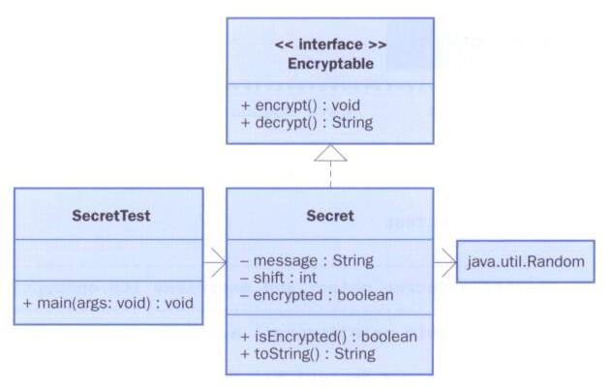
Interfaces
In UML, a dotted arrow is used to show that a class implements an interface
The designation <<interface>> is used to indicate an interface

Slide 20
Interfaces
A class can implement multiple interfaces
The interfaces are listed in the implements clause
The class must implement all methods in all interfaces listed in the header
class ManyThings implements Interface1, Interface2
{
// all methods of both interfaces
}

Slide 21
Interfaces
The Java API contains many helpful interfaces
The Comparable interface contains one abstract method called compareTo, which is used to compare two objects
The String class implements Comparable, giving us the ability to put strings in lexicographic order

Slide 22
The Comparable Interface
Any class can implement Comparable to provide a mechanism for comparing objects of that type
if (obj1.compareTo(obj2) < 0)
System.out.println("obj1 is less than obj2");
The value returned from compareTo should be negative is obj1 is less that obj2, 0 if they are equal, and positive if obj1 is greater than obj2
When you design a class that implements the Comparable interface, it should follow this intent

Slide 23
The Comparable Interface
It’s up to the programmer to determine what makes one object less than another
For example, you may define the compareTo method of an Employee class to order employees by name (alphabetically) or by employee number
The implementation of the method can be as straightforward or as complex as needed for the situation

Slide 24
Interfaces
You could write a class that implements certain methods (such as compareTo) without formally implementing the interface (Comparable)
However, formally establishing the relationship between a class and an interface allows Java to deal with an object in certain ways
Which brings us back to polymorphism

Slide 25
References and Interfaces
Suppose we have an interface called Speaker:
public interface Speaker
{
public void speak();
public void announce(String str);
}
The interface name can now be used as the type of a reference variable:
Speaker current;
The variable current can now point to any object of any class that implements Speaker

Slide 26
Polymorphism via Interfaces
The version of speak that the following line invokes depends on the type of object that current is referencing:
current.speak();
This is analogous to the technique for polymorphism using inheritance

Slide 27
Polymorphism via Interfaces
Suppose two classes, Philosopher and Dog, both implement the Speaker interface, providing distinct versions of the speak method
In the following code, the first call to speak invokes one version and the second invokes another:
Speaker guest = new Philospher();
guest.speak();
guest = new Dog();
guest.speak();...

